Slide 1

NASA Carbon Monitoring System (NASA-CMS)
NASA Carbon Monitoring System
Science Team Overview
George Hurtt
NASA-CMS Science Team Leader
Department of Geographical Sciences
University of Maryland
gchurtt@umd.edu
Science Team Meeting
November 12-14, 2014
Bethesda, MD
Notes:
Combines:
-Congressional direction (2010) for “pre-phase A and pilot initiatives for the development of a carbon monitoring system.”…Renewed in 2012…
-NASA’s long term interest/ability in Earth system science, and carbon cycle science in particular

Slide 2



NASA-CMS Phase 1
Biomass Pilot. The goals of the Biomass Pilot are to:
Utilize satellite and in situ data to produce quantitative estimates (and uncertainties)
of aboveground terrestrial vegetation biomass on a national and local scale.
Assess the ability of these results to meet the nations need for monitoring
carbon storage/sequestration.
Flux Pilot. The objectives of the Flux Pilot are to:
Combine satellite data with modeled atmospheric transport initiated by
observationally-constrained terrestrial and oceanic models to tie the atmospheric
observations to surface exchange processes.
Estimate the atmosphere-biosphere CO₂ exchange.
Scoping Efforts. The objectives of the Scoping Efforts are to:
Identify research, products, and analysis system evolutions required to support carbon
policy and management as global observing capability increases.
Notes:
-Congressional direction to NASA in 2010-
-Phase one organized into pilots and scoping efforts

Slide 3
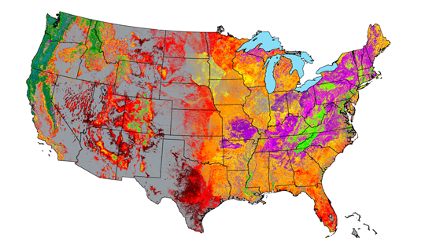
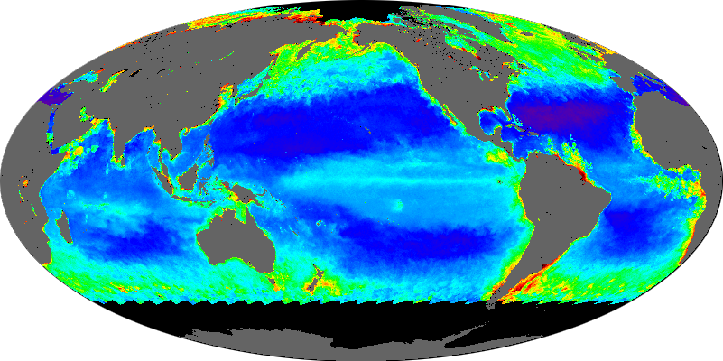
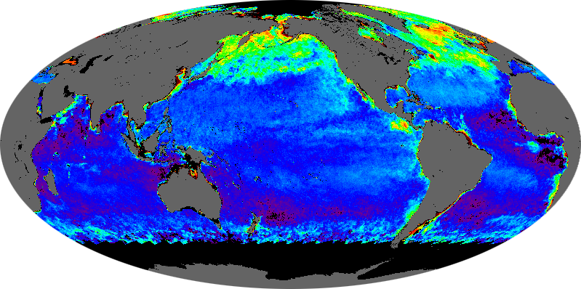
NASA-CMS Phase 1 Examples
Notes:
Biomass National Pilot- Saatchi et al. 250m biomass map.
Biomass Local- Cook, Dubayah, Hurtt et al. 90m biomass map and c sequestration estimates for 2 counties in MD.
Flux-Pawson et al., system diagram
Oceans- Behrenfeld et al. Study to address link between chi and b

Slide 4

Gridded Mass Balance
One pool,
Multiple fluxes (j)
ΔStock=Σ(Flux_{j})
e.g. Global atmospheric
Carbon budget
Multiple pools (i),
Mulitple fluxes (j)
ΔStock_{i}=Σ(Flux_{i,j})
e.g. atmoshere, land,
Ocean, etc.
Multiple pools (i),
Multiple fluxes (j),
Gridded (k)
ΔStock_{i,k}=Σ(Flux_{i,j,k})
e.g. Potential NASA-CMS
-> Overlay relevant NASA products
And uncertainties
-> i.d. capabilities, strengths, gaps
-> match/optimize to user needs

Slide 5








CMS Award year: # of projects (decision support - MRV)
2012: 20
2013: 17
2014: 15
Global Surface-Atmosphere Flux
2012: 2
2014: 3 (2)
Land-Atmosphere Flux
2012: 6 (5)
2013: 8 (6)
2014: 2 (2)
Ocean-Atmosphere Flux
2012: 1
Ocean Biomass
2012: 3
Land-Ocean Flux
2012: 1
2014: 1 (1)
Land Biomass
2012: 7 (5)
2013: 9 (9)
2014: 9 (7)

Slide 6
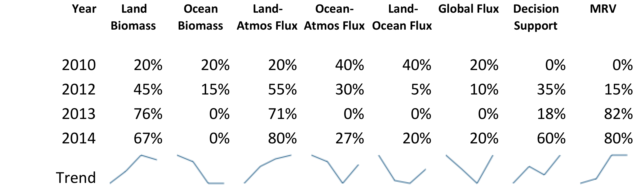
Award Year and Themes Addressed

Slide 7
NASA-CMS Working Groups
Responsiveness (Sean Healey)
Capability Risk (Josh Fisher)
External Communications (Molly Brown, Ariane Verdy)
System Framework (Kevin Bowman, Steve Pawson)
Uncertainties (Robert Kennedy)
Algorithm Assessment (Sangram Ganguly, Scott Powell)
Biomass-Flux (Jim Collatz, Scott Denning)
Atmoshpheric Validation (Heather Graven)
MRV (Richard Birdsey)
Data/Data Management (Kathy Hibbard)

Slide 8
Applications Workshop Summary
Excellent interaction and input from stakeholders working with NASA-CMS projects, across a range of spatial/policy scales (subnational, national, international, and ocean).
Stakeholders very pleased and encouraged by CMS activities, emerging capabilities, and future potential
CMS should not just about data products, but also about addressing policy relevant science questions
Importance of baseline, monitoring, and projection/prediction, and attribution
Importance of uncertainty quantification, “accuracy willing to pay for”
Importance of state of art capability, leadership in CMS capabilities
Input is timely, with very aggressive policy timelines nationally/internationally
Need to get ahead in understanding future policy needs and future capabilities
Data Delivery? Don’t, make data available in std GIS format.

Slide 9
NASA-CMS Timeline
2010: First Congressional Direction re CMS, Initiate NASA-CMS Phase 1
2012/08: Phase 2 Selections (20), Science Team Initiated, Team Leader Begins
2012/11: 1st Science Team Meeting
2012: New Congressional Direction
2013/02: NACP Meeting
  Breakout Session: North American Terrestrial Carbon Monitoring and
  Decision Support Capabilities
2013/04: NASA Terrestrial Ecology Meeting,
  Breakout Session: Exploring NASA-CMS and TE Synergies
2013/08: Phase 2 Selections (17)
2013/11: 2nd Science Team Meeting
2014: New Congressional Direction
2014/06: CMS Phase 1 Report Released
2014/07: CMS Selections (15)
2014/10: CMS MRV Plan Released
2014/11: 3rd Science Team Meeting including Applications Workshop
2015/01: NACP Meeting
  Breakout Session: Partnerships for CMS
2015/04: NASA Joint Science Meeting

Slide 10
Meeting Goals
Update on NASA perspective and goals
Presentation and assessment of CMS (2012 and 2013 projects) Science Team Results
Introduction of new CMS (2014 projects) team members and projects
Advance and share working group progress
Development and prioritization of science team goals and action items for 2014-2015

Slide 11
Key Questions
What are the current capabilities, strengths, weaknesses, gaps of NASA-CMS?
What are the most important new directions, needs, and opportunities for NASA-CMS?
What are the win-win benefits of CMS for science and application?
How should NASA-CMS organize and improve its functioning?
Can/should we envision a “national CMS”, and what would should it look like?

